Slide 1
Virtual Function & Pure Virtual Function

Slide 2
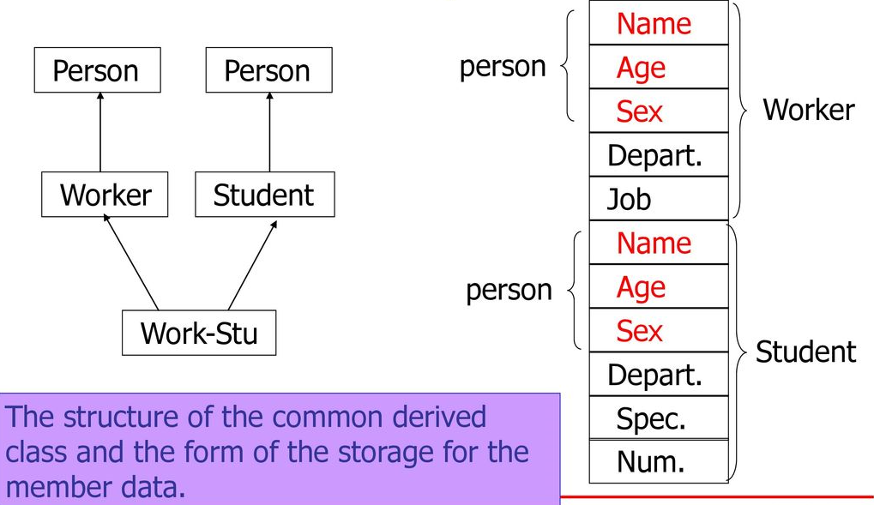

Slide 3
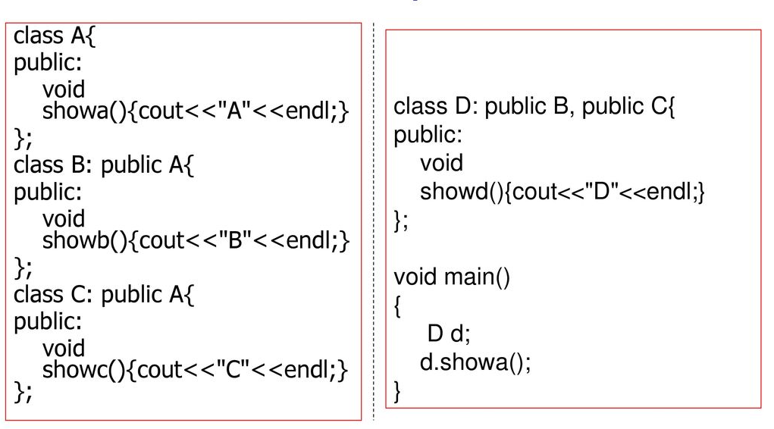

Slide 4
Virtual Function
A virtual function is a member function which is declared within a base class and is re-defined (overridden) by a derived class.
When we refer to a derived class object using a pointer or a reference to the base class, we can call a virtual function for that object and execute the derived class’s version of the function.
Virtual functions ensure that the correct function is called for an object, regardless of the type of reference (or pointer) used for function call.
They are mainly used to achieve runtime polymorphism.
Functions are declared with a virtual keyword in base class.
The resolving of function call is done at runtime.

Slide 5
Rules for Virtual Function
Virtual functions cannot be static.
A virtual function can be a friend function of another class.
Virtual functions should be accessed using pointer or reference of base class type to achieve runtime polymorphism.
The prototype of virtual functions should be the same in the base as well as derived class.
They are always defined in the base class and overridden in a derived class. It is not mandatory for the derived class to override (or re-define the virtual function), in that case, the base class version of the function is used.
A class may have virtual destructor but it cannot have a virtual constructor.

Slide 6
Example 1
#include<iostream>
using namespace std;
class base {
public:
virtual void print() {
cout << "print base class\n";
}
void show() {
cout << "show base class\n";
}
};
class derived : public base {
public:
void print() {
cout << "print derived class\n";
}
void show() {
cout << "show derived class\n";
}
};
int main() {
base *bptr;
derived d;
bptr = &d;
bptr->print();
bptr->show();
return 0;
}

Slide 7
Example 2
#include<iostream>
using namespace std;
class base {
public:
void fun_1() { cout << "base-1\n"; }
virtual void fun_2() { cout << "base-2\n"; }
virtual void fun_3() { cout << "base-3\n"; }
virtual void fun_4() { cout << "base-4\n"; }
};
class derived : public base {
public:
void fun_1() { cout << "derived-1\n"; }
void fun_2() { cout << "derived-2\n"; }
void fun_4(int x) { cout << "derived-4\n"; }
};
int main() {
base *p;
derived obj1;
p = &obj1;
p->fun_1();
// Late binding (RTP)
p->fun_2();
p->fun_3();
p->fun_4();
return 0; }

